Slide 1
Beyond Single Modality: Multi-Modal Ensemble Learning for Enhanced Plant Disease Detection
By
Dr Kiran Babu (Supervisor)
G Pushpak 520222
Raju Yadav 520225
Rajkishor 520224

Slide 2
Flow Of Presentation
Abstract
Introduction
Literature Review
Problem Statement
Objectives
Proposed Methodology
Results of Single Modality
Problems Faced
Final Result
References
Future Scope

Slide 3
Abstract
This study presents a novel approach to plant disease detection using multi-modal ensemble learning. By integrating color, grayscale, and segmented images processed through deep learning models like Inception and VGG16 via transfer learning, we achieve a 96% accuracy rate. Our method enhances disease detection reliability and demonstrates the potential of ensemble techniques in agriculture. This research contributes to advancing plant disease detection technology for sustainable agriculture by providing a robust and accurate detection system. The findings highlight the effectiveness of combining diverse modalities and ensemble learning for addressing complex agricultural challenges.

Slide 4
Introduction
Our project aims to revolutionize plant disease detection by leveraging cutting-edge deep learning techniques. Through the fusion of multi-modal ensemble learning and transfer learning, we seek to develop a robust system capable of accurately identifying diseases in plants based on color, grayscale, and segmented leaf images. By harnessing the power of convolutional neural networks (CNNs) such as VGG16 and InceptionV3, we aim to achieve superior accuracy and efficiency in disease classification.

Slide 5
Literature Review
The paper by Kulkarni et al. (2021), emphasize the significance of their approach in utilizing segmented images for plant disease detection, highlighting its effectiveness in achieving an accuracy of 88%. Discuss the context of previous research in plant disease detection and the role of segmented image processing techniques within this domain. [1]
In the literature review for the paper by Mohanty et al. (2016), highlight the pioneering use of deep learning for image-based plant disease detection, showcasing their utilization of color, grayscale, and segmented images. Emphasize the significance of their multi-modal approach, which inspired our ensemble learning methodology. [2]
In their paper, Shovon et al. (2023) introduce PlantDet, a multi-model ensemble method for plant disease detection using deep learning. Their approach inspires our ensemble methodology, emphasizing the efficacy of combining diverse neural architectures for improved accuracy. This highlights the growing importance of ensemble techniques in advancing automated plant disease detection systems.[5]

Slide 6
Problem Statement
Plant diseases pose significant threats to global food security, leading to substantial crop losses and economic impacts. Traditional methods of disease detection often rely on manual inspection, which is time-consuming, labor-intensive, and prone to human error. Additionally, existing automated detection systems primarily focus on single modality data, such as color images, which may limit their effectiveness in accurately identifying diseases across diverse plant species and environments.
Addressing these challenges, this study aims to develop an advanced plant disease detection system that goes beyond single-modality approaches. By leveraging multi-modal ensemble learning techniques, including color, grayscale, and segmented images processed through deep learning models, the goal is to create a robust and accurate detection system capable of identifying a wide range of plant diseases across various crop species.

Slide 7
Objectives
Exploration of Multi-Modal Ensemble Learning: Investigate the effectiveness of multi-modal ensemble learning techniques for plant disease detection by integrating color, grayscale, and segmented images.
Evaluation of Deep Learning Models: Assess the performance of different deep learning models, including Inception and VGG16, in processing diverse image modalities and their impact on detection accuracy.
Comparison with Single-Modality Approaches: Compare the performance of the proposed multi-modal ensemble approach with traditional single-modality methods to determine its superiority in disease detection accuracy.

Slide 8
Methodology
Data Collection:
Gather a diverse dataset comprising color, grayscale, and segmented images of plants affected by various diseases. Ensure the dataset covers a wide range of plant species and disease manifestations.
Preprocess the images by standardizing sizes, cropping, and normalizing pixel values to facilitate uniform input across deep learning models.

Slide 9
Methodology
Data Augmentation:
Implemented data augmentation with ImageDataGenerator, standardizing pixel values by rescaling images to 1/255. Rotation up to 30 degrees, shearing and zooming equal to 0.2, and shifting applied within specified ranges to introduce variability.
Utilized augmentation techniques to diversify the dataset, enhancing robustness and generalization of deep learning models for plant disease detection. Horizontal flipping and nearest fill mode employed alongside a validation split of 0.2 for effective separation of validation data.

Slide 10
Methodology
Model Selection and Training:
Choose suitable deep learning models for processing each image modality, such as Inception and VGG16.
Apply transfer learning by initializing the selected models with pre-trained weights on large-scale datasets like ImageNet.
Fine-tune the models on the plant disease dataset to adapt them to the specific detection task, adjusting hyperparameters as needed.
Train individual models for each image modality separately to optimize performance.

Slide 11
Methodology
Ensemble Learning:
Combine predictions from the trained models using ensemble techniques such as averaging or weighted voting.
Experiment with different ensemble strategies to determine the most effective approach for improving overall detection accuracy.
Implement ensemble fusion at various levels, including feature level, decision level, or model level, to exploit complementary information from different modalities.

Slide 12
Methodology
Performance Evaluation: We quantitatively evaluated the performance of individual models and the ensemble system primarily based on accuracy metrics. By measuring the accuracy of each model on a separate validation dataset, we obtained insights into their ability to correctly classify plant diseases from input images.
Training and Validation Curves: We generated training and validation accuracy curves for each model during the training process. These curves provided a visual representation of the models' learning dynamics over epochs, indicating their convergence and potential for overfitting or underfitting.
Cross-Validation: To ensure the robustness and generalization of our models, we employed cross-validation techniques. By splitting the dataset into multiple subsets and training the models on different combinations of training and validation data, we assessed their performance across diverse scenarios.

Slide 13
Ensemble Learning
In this project, ensemble learning plays a pivotal role in enhancing the accuracy and robustness of the plant disease detection system. Ensemble learning is a powerful technique that combines multiple base models to make more accurate predictions than any individual model alone. Here's how ensemble learning is utilized in this project:
Integration of Multiple Modalities: Ensemble learning allows for the integration of predictions from models trained on different image modalities, including color, grayscale, and segmented images. Each modality captures unique information about the plant and its disease manifestations. By combining predictions from these diverse modalities, the ensemble system leverages complementary information to make more accurate overall predictions.

Slide 14
Ensemble Learning
Model Diversity: Ensemble learning exploits the diversity of models trained on different deep learning architectures, such as InceptionV3 and VGG16. Each model may have strengths and weaknesses in capturing different features or patterns in the input data. By combining predictions from diverse models, the ensemble system mitigates individual model biases and errors, resulting in more robust predictions.
Ensemble Fusion Techniques: Various ensemble fusion techniques are employed to combine predictions from individual models. These techniques may include simple averaging or weighted voting, where each model's prediction is assigned a weight based on its performance on a validation set.

Slide 15
Ensemble Learning
Decision-Level Fusion: Ensemble learning facilitates decision-level fusion, where the final prediction is made based on the collective decisions of the individual models. For example, if a majority of models predict a certain disease class for a given image, the ensemble system will assign that class label as the final prediction.
Overall, ensemble learning serves as a powerful tool for aggregating information from multiple sources and models, thereby enhancing the performance of the plant disease detection system. By leveraging the complementary strengths of different modalities and models, the ensemble system achieves higher accuracy and reliability in identifying plant diseases, ultimately contributing to improved agricultural sustainability and crop yield.

Slide 16
Transfer Learning
Utilizing Pre-trained Models:
Transfer learning allows you to leverage pre-trained deep learning models that have been trained on large-scale datasets, such as ImageNet.
Instead of training a deep neural network from scratch, which requires a large amount of labeled data and computational resources, you can start with a pre-trained model that has already learned generic features from a diverse set of images.
Feature Extraction:
Pre-trained models serve as powerful feature extractors. They have learned to detect low-level features like edges, textures, and shapes in images, which are often useful for various computer vision tasks.
By fine-tuning these pre-trained models on your specific dataset of plant images, you can adapt the learned features to the task of plant disease detection without starting from scratch.

Slide 17
Transfer Learning
Addressing Data Scarcity:
One of the main challenges in machine learning, especially in domains like plant disease detection, is the scarcity of labeled data.
Transfer learning allows you to overcome this challenge by transferring knowledge from a large dataset (e.g., ImageNet) to your smaller dataset of plant images. This helps improve model generalization and performance, even with limited labeled data.
Reducing Training Time and Resource Requirements:
Training deep learning models from scratch can be computationally expensive and time-consuming, requiring powerful GPUs and significant training time.
Transfer learning reduces the training time and resource requirements by initializing the model with pre-learned weights and fine-tuning only the top layers of the network on your specific dataset. This process requires fewer training epochs and less computational power compared to training from scratch.

Slide 18
Transfer Learning
Improving Performance:
By leveraging the knowledge encoded in pre-trained models and fine-tuning them on your dataset, transfer learning often leads to better performance compared to training from scratch, especially when the pre-trained model is well-suited to the task at hand.
The pre-trained models have already learned to extract relevant features from images, which can significantly boost the performance of your plant disease detection models.
Overall, transfer learning has likely provided a powerful and efficient way to build accurate plant disease detection models, enabling you to achieve high accuracy even with limited labeled data and computational resources

Slide 19
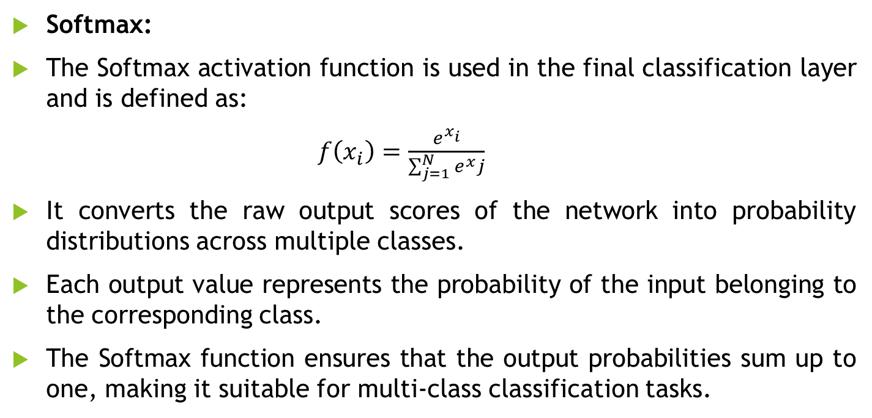
Activation Function
Softmax:
The Softmax activation function is used in the final classification layer and is defined as:
$f\left(x_{i}\right)=\frac{ⅇ^{x_{i}}}{\sum_{j=1}^{N}{ⅇ^{x}j}}$
It converts the raw output scores of the network into probability distributions across multiple classes.
Each output value represents the probability of the input belonging to the corresponding class.
The Softmax function ensures that the output probabilities sum up to one, making it suitable for multi-class classification tasks.

Slide 20
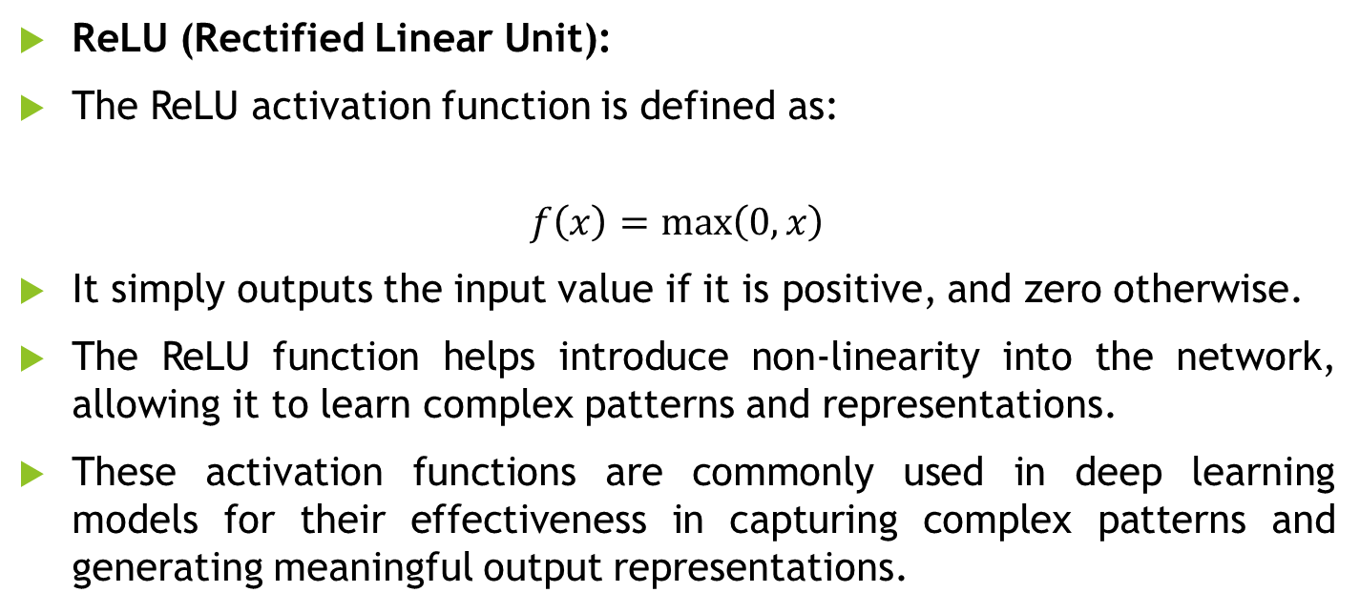
Activation Function
ReLU (Rectified Linear Unit):
The ReLU activation function is defined as:
$$f\left(x\right)=\max\left(0,x\right)$$
It simply outputs the input value if it is positive, and zero otherwise.
The ReLU function helps introduce non-linearity into the network, allowing it to learn complex patterns and representations.
These activation functions are commonly used in deep learning models for their effectiveness in capturing complex patterns and generating meaningful output representations.

Slide 21
Loss Function
The loss function used in the provided code is Categorical Cross entropy.
Categorical Cross entropy is a commonly used loss function in classification tasks, particularly when the output labels are one-hot encoded. It measures the dissimilarity between the true labels and the predicted probabilities assigned by the model for each class.
Minimizing the categorical cross entropy loss encourages the model to assign high probabilities to the correct classes and penalizes deviations from the true label assignments. This loss function is well-suited for multi-class classification tasks, such as the one described in the provided code snippet.

Slide 22
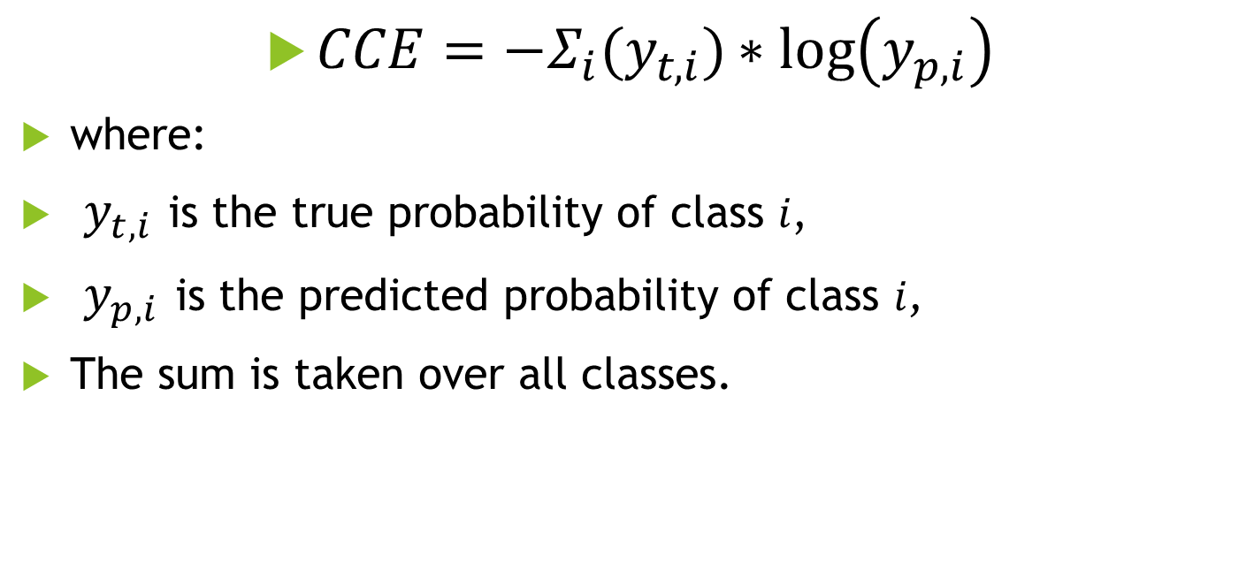
Loss Function
$CCE=−Σ_{i}{(y}_{t,i})∗log\left(y_{p,i}\right)$
where:
$y_{t,i}$ is the true probability of class 𝑖,
$y_{p,i}$ is the predicted probability of class 𝑖,
The sum is taken over all classes.

Slide 23
Ensemble Techniques
Averaging Ensemble:
For each modality (color, grayscale, segmented), predictions are made using two models (InceptionV3 and VGG16).
The predictions from both models are averaged to obtain ensemble predictions for each modality.
This averaging ensemble technique helps mitigate the weaknesses of individual models and produces more robust predictions by leveraging the collective knowledge of both models.

Slide 24
Ensemble Techniques
Voting Ensemble:
After obtaining ensemble predictions for each modality, the predictions from all three modalities (color, grayscale, segmented) are stacked vertically.
The mode (most common prediction) is computed along the columns (axis=0) of the stacked predictions array, effectively combining the predictions from all models by selecting the most commonly predicted class for each sample.
This voting ensemble technique further enhances the robustness of predictions by aggregating the decisions of multiple models and potentially reducing prediction errors.

Slide 25
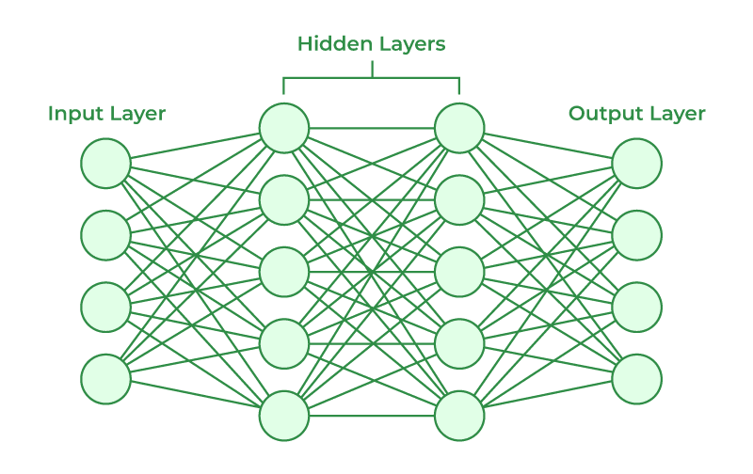
Neural Networks Unveiled: Navigating the Landscape of Artificial Intelligence

Slide 26


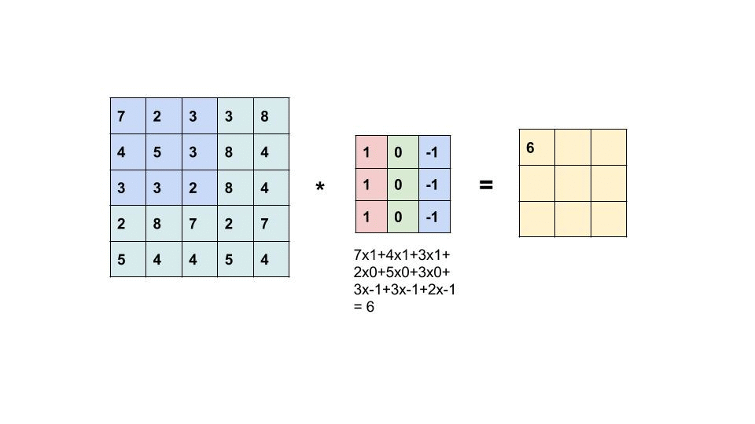
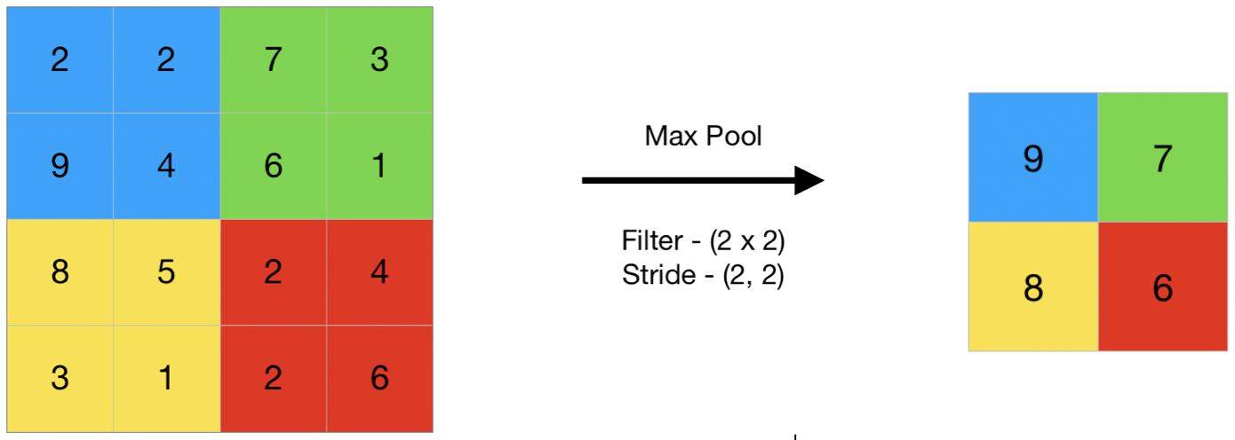

Slide 27

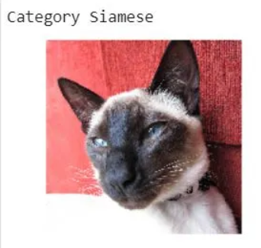


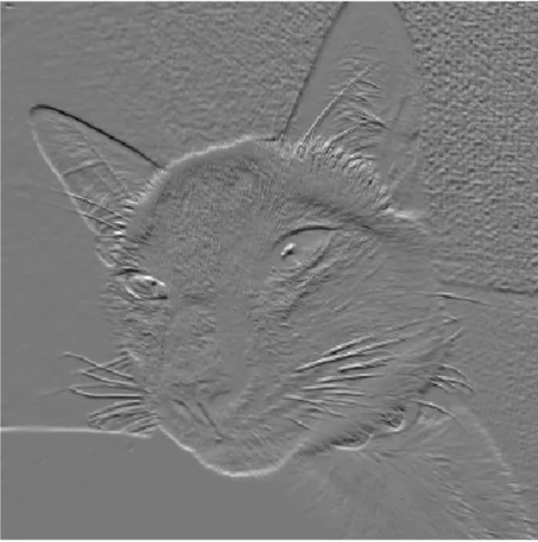

Slide 28
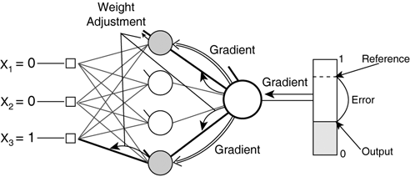
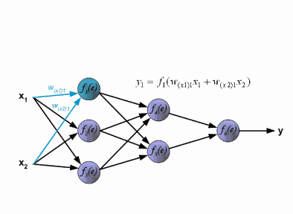
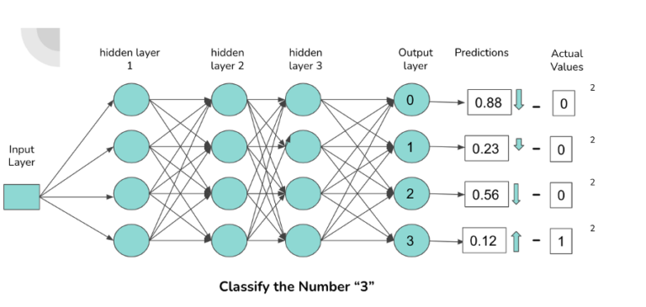
Backpropagation

Slide 29
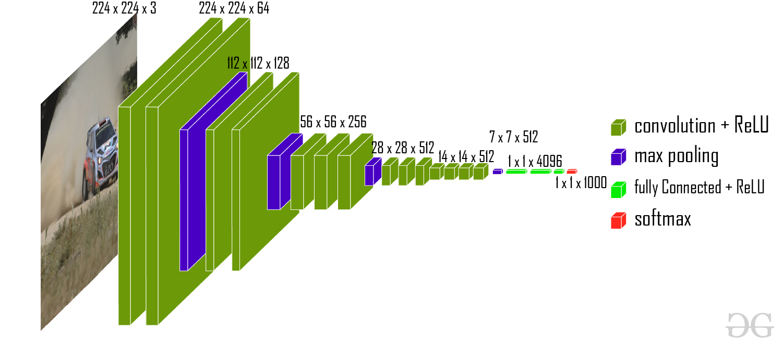
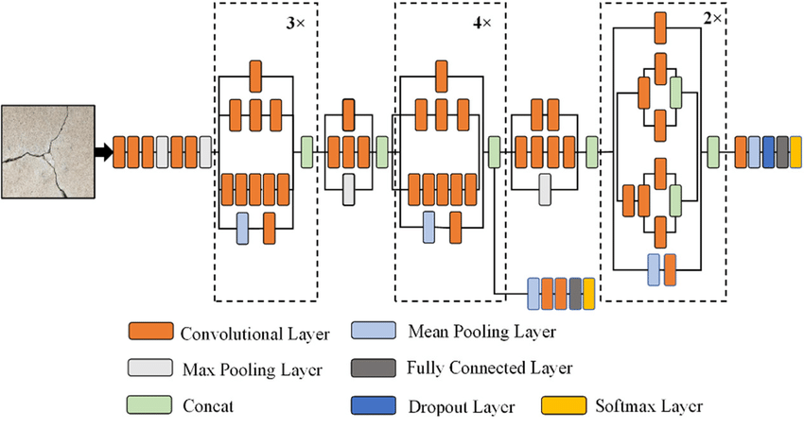
VGG16 Model
InceptionV3

Slide 30
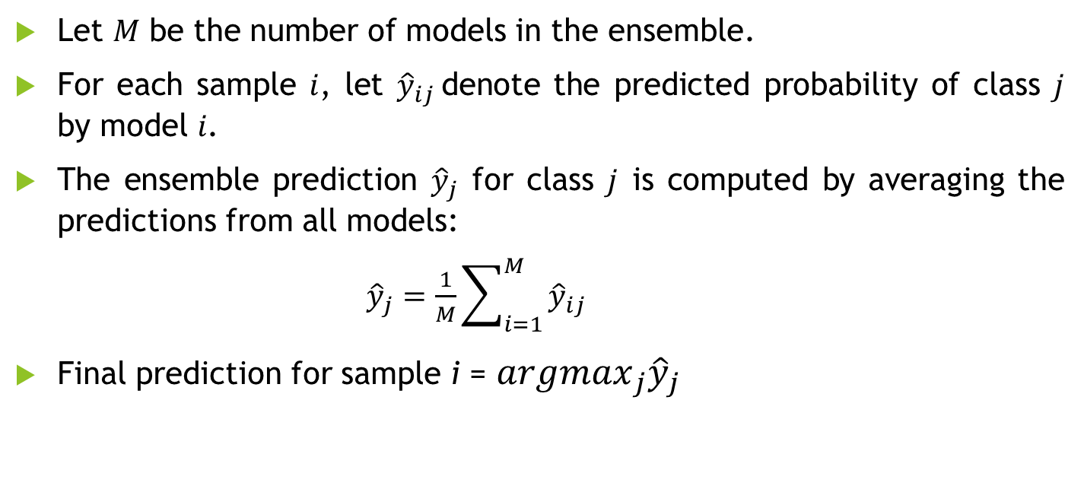
Averaging Ensemble
Let 𝑀 be the number of models in the ensemble.
For each sample 𝑖, let ${\hat{y}}_{ij}$denote the predicted probability of class 𝑗 by model 𝑖.
The ensemble prediction ${\hat{y}}_{j}$ for class 𝑗 is computed by averaging the predictions from all models:
${\hat{y}}_{j}=\frac{1}{M}\sum_{i=1}^{M}{{\hat{y}}_{ij}}$
Final prediction for sample i = ${argmax}_{j}{\hat{y}}_{j}$

Slide 31
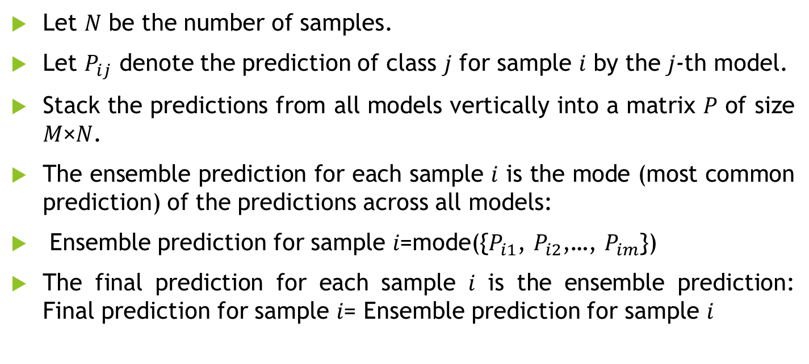
Voting Ensemble
Let 𝑁 be the number of samples.
Let $P_{ij}$ denote the prediction of class 𝑗 for sample 𝑖 by the 𝑗-th model.
Stack the predictions from all models vertically into a matrix 𝑃 of size 𝑀×𝑁.
The ensemble prediction for each sample 𝑖 is the mode (most common prediction) of the predictions across all models:
Ensemble prediction for sample 𝑖=mode({$P_{i1}$, $P_{i2}$,…, $P_{im}$})
The final prediction for each sample 𝑖 is the ensemble prediction: Final prediction for sample 𝑖= Ensemble prediction for sample 𝑖

Slide 32
Accuracy of Models
Models | Accuracy
Inception Color Model | 88.60724
Inception Gray Model | 84.87418
Inception Segmented Model | 90.28481
VGG16 Color Model | 93.15144
VGG16 Gray Model | 89.40916
VGG16 Segmented Model | 91.53839

Slide 33
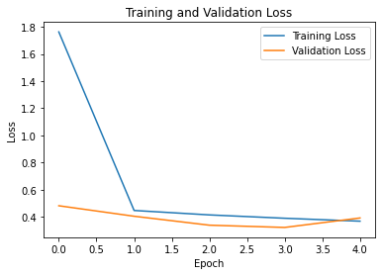
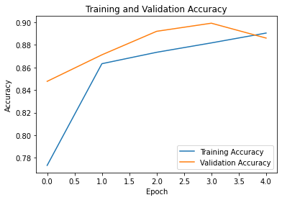
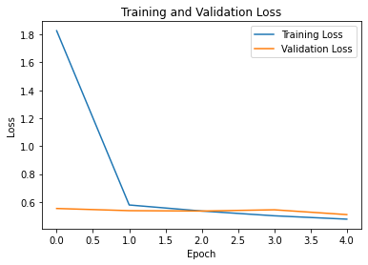
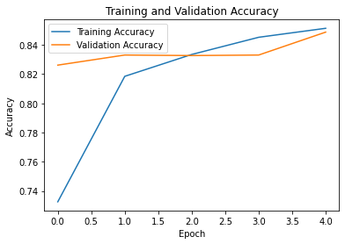
Inception Color Model
Inception Gray Model

Slide 34
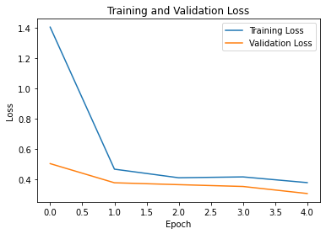
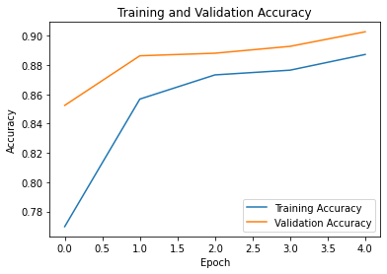
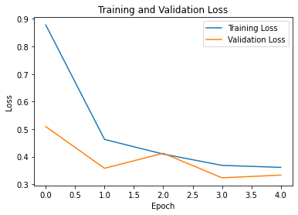
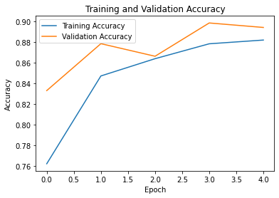
Inception Segmented Model
VGG16 Gray Model

Slide 35
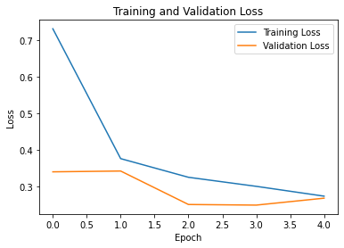
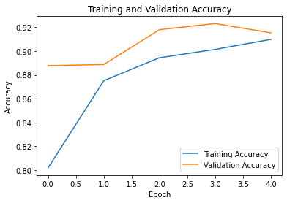
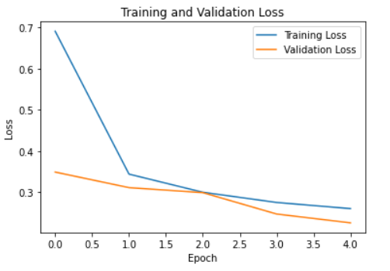
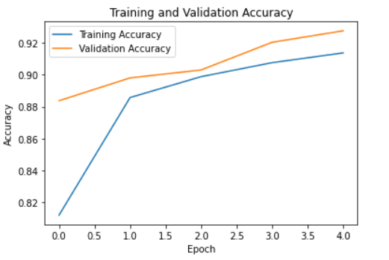
VGG16 Segmented Model
VGG16 Color Model

Slide 36
Models
Inception Color Model
Inception Gray Model
Inception Segmented Model
VGG16 Color Model
VGG16 Gray Model
VGG16 Segmented Model
Ensembled Color Model
Ensembled Gray Model
Ensembled Segmented Model

Slide 37
Accuracy of Ensembled Models
Ensembled Models | Accuracy
Ensembled Color Model | 95.06866
Ensembled Gray Model | 91.23421
Ensembled Segmented Model | 94.38657

Slide 38
Problems Faced
Pre-trained Models Trained on RGB Images:
Many pre-trained deep learning models, such as those trained on ImageNet, are trained on RGB (Red, Green, Blue) color images. These models expect input images with three color channels (RGB).
If you directly feed grayscale images (with only one color channel) into such pre-trained models, you'll need to ensure compatibility by either converting the grayscale images to RGB format or modifying the model architecture to accept grayscale inputs.
Loss of Information:
Grayscale images contain only intensity information (one channel) compared to RGB images, which contain information about color (three channels). As a result, grayscale images may potentially lose some information present in the color images.

Slide 39
How Problem is Solved?
Load Grayscale Image:
Grayscale images typically have only one channel, representing the intensity of brightness. Each pixel in the image has a single intensity value ranging from 0 to 255, where 0 is black and 255 is white.
Duplicate Grayscale Channel:
To convert the grayscale image to a color image, we need to create three color channels: red, green, and blue (RGB). However, since the grayscale image has only one channel, we duplicate this channel twice to create three identical channels.

Slide 40
How Problem is Solved?
Merge Channels:
Once we have three identical channels, we merge them together to create a single color image. This merging process combines the three grayscale channels into one image, effectively replicating the intensity values across all three color channels.
Resulting Color Image:
The resulting color image appears as if it were a grayscale image but with three channels instead of one. Each pixel in the image now has the same intensity value in all three color channels, resulting in shades of gray ranging from black to white.

Slide 41
Model Proposed
Set of Color Images
Ensembled Color Model
Set of Gray Images
Ensembled Gray Model
Final Output
Set of Segmented Images
Ensembled Segmented Model

Slide 42
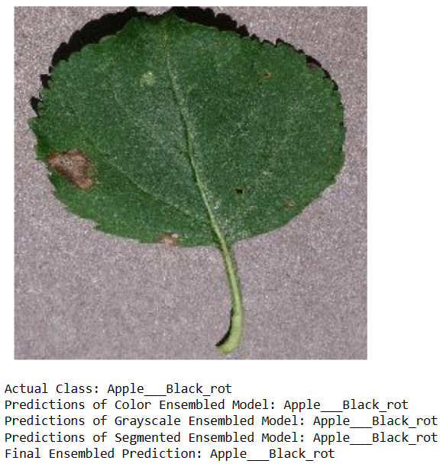
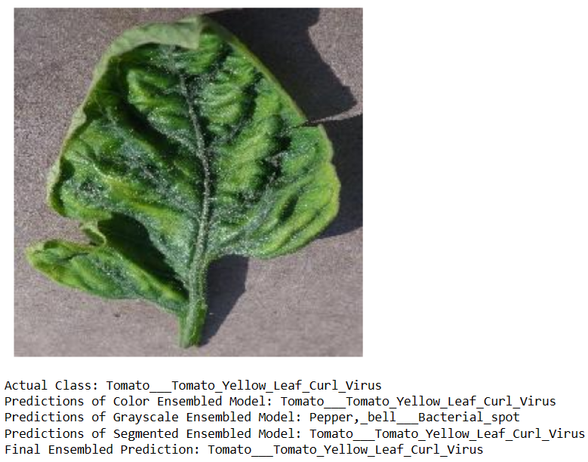
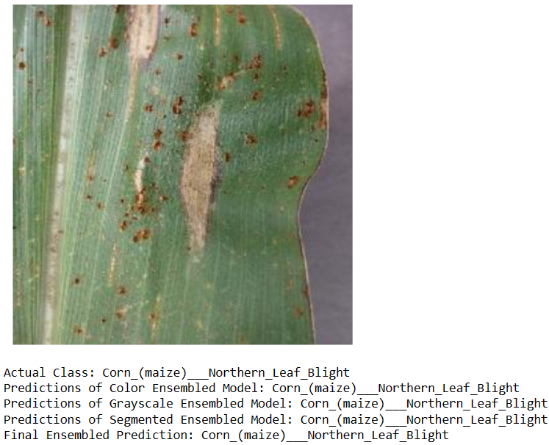
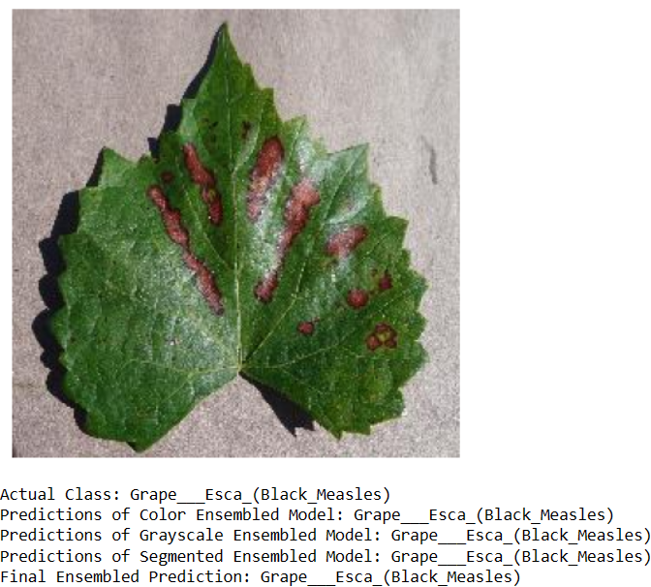
Results of Triple Ensemble Fusion Model

Slide 43
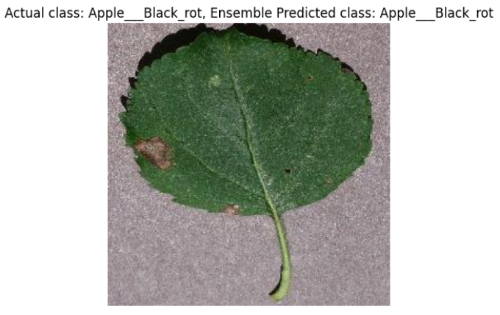
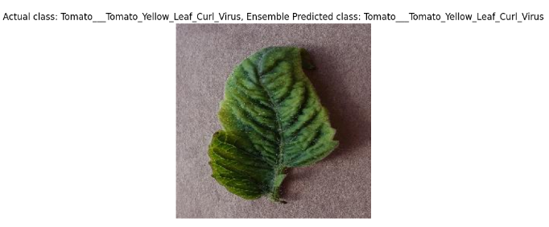
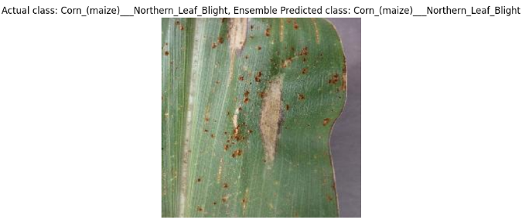
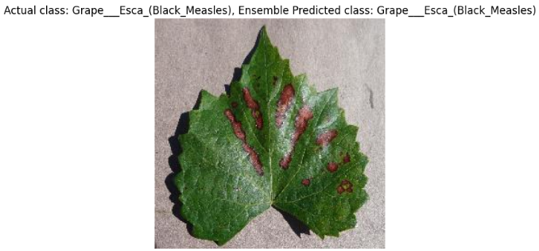
Results of Ensembled Color Model

Slide 44
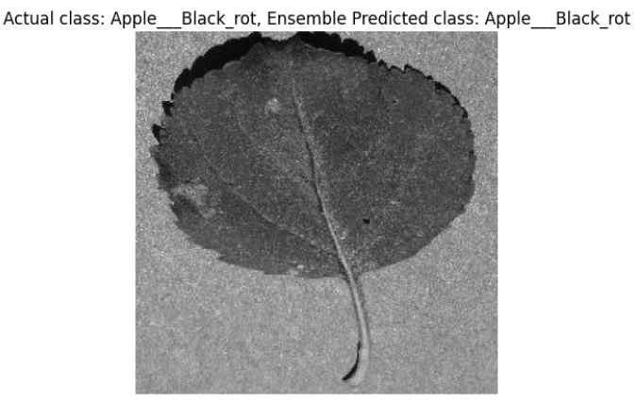
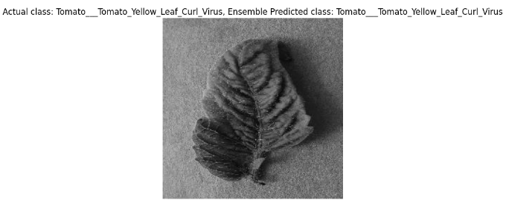
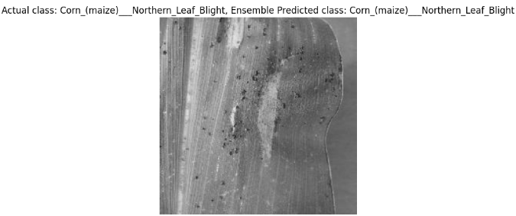
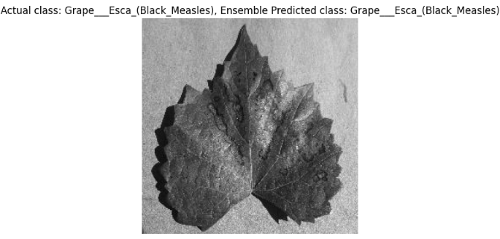
Results of Ensembled Gray Model

Slide 45
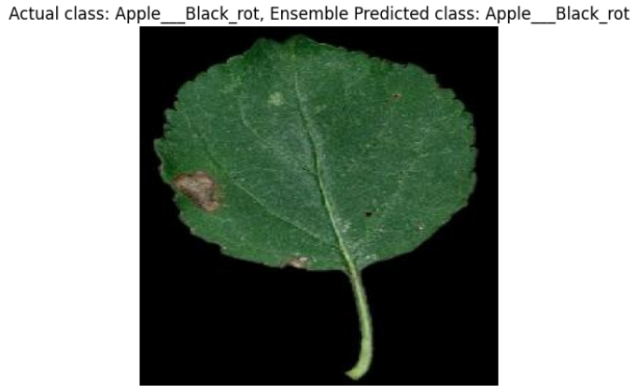
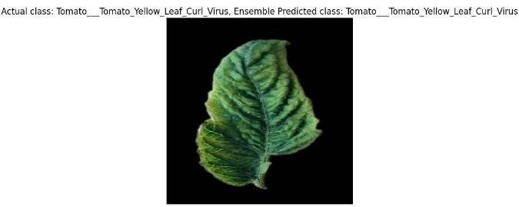
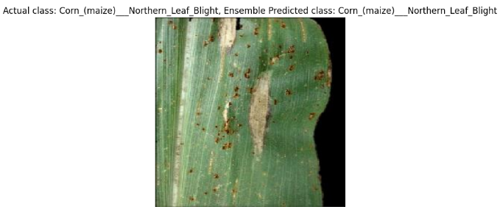
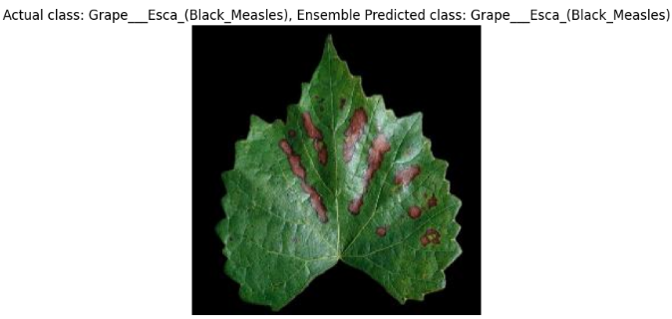
Results of Ensembled Segmented Model

Slide 46

Results and Comparison
Model | Accuracy
Triple Ensemble Fusion Model | 96.04571
Ensembled Color Model | 95.06866
Ensembled Gray Model | 91.23421
Ensembled Segmented Model | 94.38657
Inception Color Model | 88.60724
Inception Gray Model | 84.87418
Inception Segmented Model | 90.28481
VGG16 Color Model | 93.15144
VGG16 Gray Model | 89.40916
VGG16 Segmented Model | 91.53839

Slide 47
Future Scope
Ensemble Method Refinement for Improved Accuracy:
Investigate and implement advanced ensemble learning techniques, such as stacking, blending, or boosting, to further enhance the accuracy of disease detection models. Experimenting with novel ensemble strategies and model combinations could lead to significant improvements in prediction performance and robustness.
Localized Disease Management:
Further tailor the disease detection models to specific regions or crops by incorporating localized data and knowledge. This could involve collaborating with agricultural extension services or local experts to customize the models for the unique disease profiles and environmental conditions of different areas.

Slide 48
References
Pranesh Kulkarni , Atharva Karwande , Tejas Kolhe , Soham Kamble , Akshay Joshi , Medha Wyawahare(2021) ,Plant Disease Detection Using Image Processing and Machine Learning. arXiv preprint arXiv:2106.10698 [1]
Sharada Prasanna Mohanty David Hughes and Marcel Salathé (2016),Using Deep Learning for Image-Based Plant Disease Detection. arXiv preprint arXiv:1604.03169 [2]
H. K. Kondaveeti, K. G. Ujini, B. V. V. Pavankumar, B. S. Tarun and S. C. Gopi, "Plant Disease Detection Using Ensemble Learning," 2023 2nd International Conference on Computational Systems and Communication (ICCSC), Thiruvananthapuram, India, 2023, pp. 1-6, doi: 10.1109/ICCSC56913.2023.10142982.[3]
S. Vats and V. Chivukula, "Plant Disease Detection Using DeepNets and Ensemble Technique," 2022 IEEE International Conference on Machine Learning and Applied Network Technologies (ICMLANT), Soyapango, El Salvador, 2022, pp. 1-6, doi: 10.1109/ICMLANT56191.2022.9996468.[4]

Slide 49
References
M. S. H. Shovon, S. J. Mozumder, O. K. Pal, M. F. Mridha, N. Asai and J. Shin, "PlantDet: A Robust Multi-Model Ensemble Method Based on Deep Learning For Plant Disease Detection," in IEEE Access, vol. 11, pp. 34846-34859, 2023, doi: 10.1109/ACCESS.2023.3264835. [5]
S. Dhar, A. Vishwakarma, D. Ghanti and N. D. Jana, "Ensemble Learning based Plant Leaf Disease Classification Considering Deep Convolutional Features from Pre-trained CNN," 2022 IEEE 6th Conference on Information and Communication Technology (CICT), Gwalior, India, 2022, pp. 1-6, doi: 10.1109/CICT56698.2022.9997819.[6]

